Slide 1
Intro to gamified iLunch
What are you trying to achieve
Value
Determining value
Why is eLearning in the state that it’s in now
Motivation of organization
Cost benefit
Old ways
Spectrum of experiences
Education design
Personalized and adaptive
Outcomes and validation
Workflow design
Challenges
Cost
Perceived value
Compliance, reward and the learner’s perceived value
Outcome of gamified iLunch

Slide 2
Lydia Sani (Redwood Performance Group) @redwoodperforms
Jeremy Friedberg (Spongelab Interactive) @Spongelab

Slide 3
eLearning like all “learning” is about outcomes!

Slide 4
A game is… an interactive simulation with objectives and challenges. Why do I care!?!... Is gamification.

Slide 5
What is the purpose of “going to school?”

Slide 6
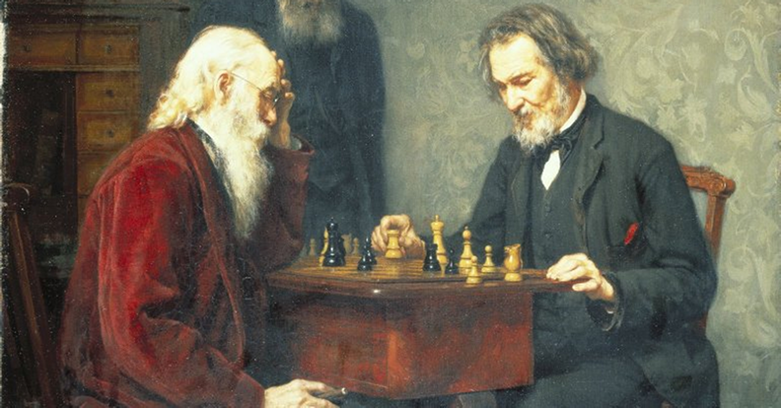
Learning is governed by the motivation of the stakeholders.

Slide 7
Learning is governed by the motivation of the stakeholders.

Slide 8
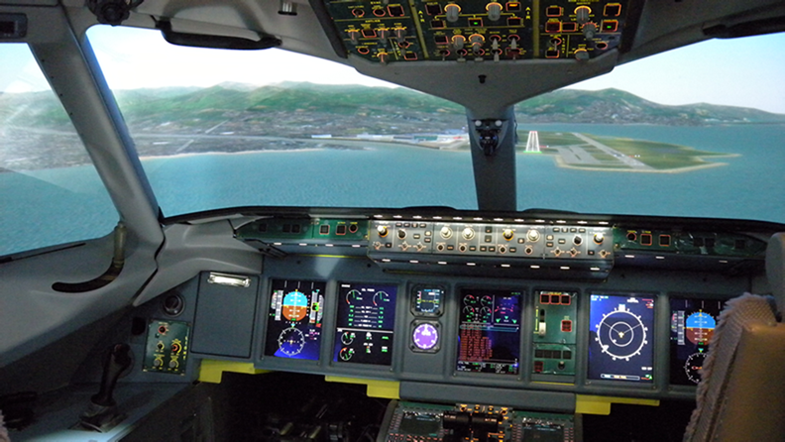
Learning is governed by the motivation of the stakeholders.

Slide 9
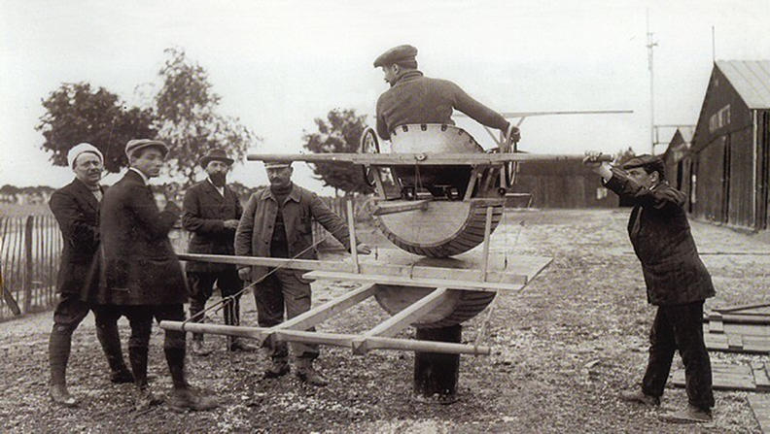
The value = (outcome achieved) – (the effort of delivery)

Slide 10
What’s the situation?
Notes:
We’ve

Slide 11
Changing the game….
Notes:
Let’s have a look at what we’re talking about.
I’m going to take you through a demo site and explain some of the key differences with Adapt courses and how in unchains us from some of the old constraints…
Using the framework you can create a responsive experience with conventional learning connectivity.
Some key features:
Demo Deep Scrolling:
The first and biggest difference is navigation - Deep scrolling page design offers navigation more natural and in sync with modern web experiences - which learners demand.
To ensure traditional tracking – there is completion tracking on course and component level which is triggered when a learner interacts with an area of a course.
Demo progress bar and menu w/ progress bar.
An immersive feeling can be achieved with graphics that fill pages widths and adjust as required across devices.
Demo Components:
Rather than using a templated approach to elearning design, Adapt utilises a flexible mix of components that can be combined seamlessly to provide a fantastic learning experience across all devices. Think of the components as building blocks that have already been programmed to work across device view port widths.
Components like Hotspot, accordion, narrative sliders, and media components.
Demo page widths:
One developed version means learning is easier to build, test and maintain.
Show Assessment component page:
Also Adapt offers great assessing functionality that’s constantly improving!

Slide 12
#1: Simple
Notes:
Simple – kids playing tag don’t require a rule book, its easy to get involved and play
--
Navigating through content can be intuitive, individual learning paths by role are easy to interact with. Touch navigation and deep scrolling create a familiar and comfortable learning experience

Slide 13
#2: Snackable
Notes:
Must be Snackable—easy to digest
Material can be consumed in any environment and in any timeframe—in the moment learning—taking advantage of opportunities as learning is needed and as learners need access
Small learning bites eg product info is divided into chunks
Spaced learning: delivering a learning piece and then people become experts and then forgot it. Learn something and then retain it when they need it.

Slide 14
#3: Seamless
Notes:
Seamless – interact with your environment
You have to build a Seamless environment. Adapt allows you to create a landscape that can allow zooming up, down, left, right and exploring deep scrolling into the landscape.
Imagine starting on a desktop at work, moving to a tablet on the train, finishing on your sofa on your phone
small chunks can be threaded together into a continuous stream, agile modules link together without having to go in and out of the LMS UI – it promotes a Netflix type of experience engaging the learner to continue with more than one episode)

Slide 15
#4: Safe
Notes:
A safe and secure environment is paramount
A responsive environment must still provide tracking, be locked down, scoring and completion
It must provide a safety net for the organization and learning and development group and the learner.
Meeting the requirements that all stakeholders can be comfortable in knowing that going forward with this approach keeps you safe
BB – secure locked down environment with full tracking

Slide 16
#5: Story
Notes:
Be free to tell a story—not just a page turner—but a simple story that people can connect to
Adapt puts the story back into learning.
As content developers we can give you the freedom to design and write your story any way you want.
It allows you to fully manage the learner experience but importantly make them want more. To feel a connection to the story and beyond to the organization to your goals.

Slide 17
#6: Learner Experience
Notes:
The learner is #6.

Slide 18
Why is eLearning so boring!?

Slide 19
GAMIFICATION
SIMULATION

Slide 21
The value in the outcomes changes with stakeholders

Slide 23
creative thinking
critical thinking
innovation
courage to take a chance

Slide 24
Innovation to free your learning….
Notes:
Let’s have a look at what we’re talking about.
I’m going to take you through a demo site and explain some of the key differences with Adapt courses and how in unchains us from some of the old constraints…
Using the framework you can create a responsive experience with conventional learning connectivity.
Some key features:
Demo Deep Scrolling:
The first and biggest difference is navigation - Deep scrolling page design offers navigation more natural and in sync with modern web experiences - which learners demand.
To ensure traditional tracking – there is completion tracking on course and component level which is triggered when a learner interacts with an area of a course.
Demo progress bar and menu w/ progress bar.
An immersive feeling can be achieved with graphics that fill pages widths and adjust as required across devices.
Demo Components:
Rather than using a templated approach to elearning design, Adapt utilises a flexible mix of components that can be combined seamlessly to provide a fantastic learning experience across all devices. Think of the components as building blocks that have already been programmed to work across device view port widths.
Components like Hotspot, accordion, narrative sliders, and media components.
Demo page widths:
One developed version means learning is easier to build, test and maintain.
Show Assessment component page:
Also Adapt offers great assessing functionality that’s constantly improving!

Slide 25
The challenges of doing it right!

Slide 26
Cost
Perceived value
Compliance, reward and the learner’s perceived value

Slide 27
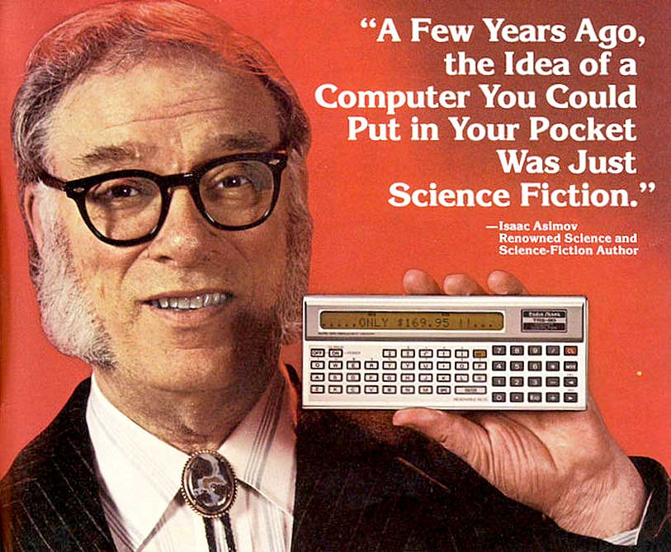
“data metrics” is the vehicle for change

Slide 28
…and the winner is?
Lydia Sani (Redwood Performance Group) @redwoodperforms
Jeremy Friedberg (Spongelab Interactive) @Spongelab

